Slide 1
Data294P First Draft Presentation
AN DL Approach On PEAK Recognition in DNA Sequence
Xiaofei Teng

Slide 2
Background Introduction
This project aims to identify peaks (high accessibility fragments on a DNA sequence), which are associated with condensate formation within Liquid-Liquid Phase Separation (LLPS), through a direct deep learning approach to learn the pattern of the original DNA sequence (the ATCGs).
The overall idea is to do a two-step approach:
Step 1: generate a label for each peak as yes/no to being a target peak
Step 2: feed the DNA sequences of the peaks together with the labels generated in step 1 to a deep neural network and train a model
Because the quality of the label will directly influence the outcome of learning, we have to be very careful when selecting methodology for step 1.

Slide 3
Background Introduction
One important feature of the peaks we are looking for is that their responses under a specific set of experimental conditions show a certain pattern.
For the three experimental conditions, namely native condition (control group), chemical fixation, and chemical fixation with 1,6-hexanediol, the accessibility read is significantly lower for the fixation group comparing to the other two groups, which no significant difference is observed. This is because under chemical fixation, the transcriptional components form multivalent, dynamic, intermolecular inter actions that are sensitive to disruption by 1,6-hexanediol⁽¹⁾.
In conclusion, we are looking for a V-shape pattern across the 3 experimental conditions.

Slide 4
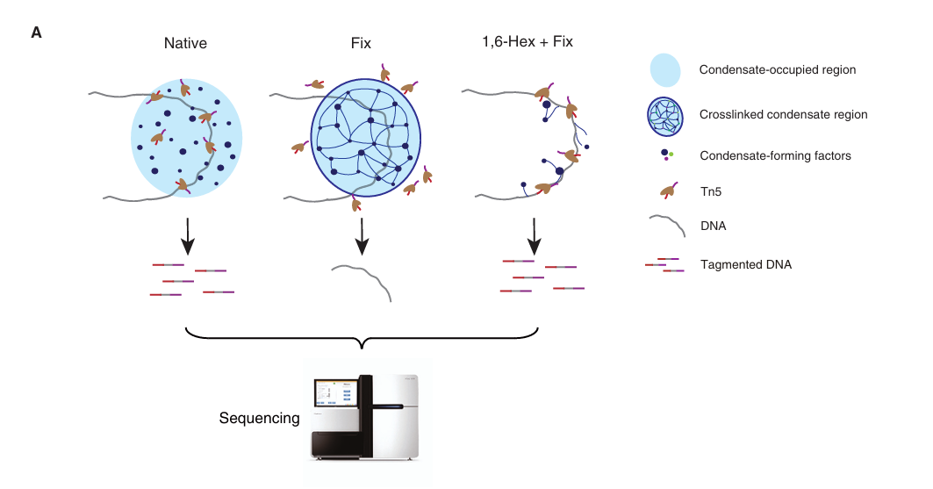
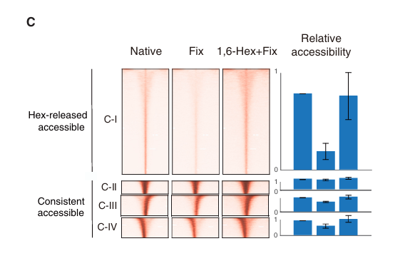

Slide 5
ATAC-seq Technique
The ATAC-seq technique enables the genome-wide detection of chromatin accessibility and plays a crucial role in various fields such as gene regulation and disease mechanisms. For an individual experimental treatment, raw data produced by ATAC-seq can be converted into a vector using some bioinformatics software. The dimension of the vector is the number of open regions or peaks, with each component representing a peak and its value indicating the relative quantification of accessibility of that peak.
Because only relative quantifications are recorded, only comparison within the same experimental group is meaningful. Thus, to compare between different groups, normalization is necessary.

Slide 6
Data Summary
The dataset is consist of 2 subsets, one of which will be used to make labels, the other to train the model.
The first subset only has 1 table, which has 68809 rows, each row represents a peak of length 400 and has 6 columns:
chrom: the name of the chrome the peak is on
start: the start point of the peak
end: the end point of the peak
Fresh: the accessibility read for the control group
Fix: the accessibility read under chemical fixation
HexFix: the accessibility read under chemical fixation with 1,6-hexanediol

Slide 7
The second subset has 2 tables, each has 137923 rows; each row represents a peak of length 600. The first table in this subset has the following columns:
chrom: the name of the chrome the peak is on
start: the start point of the peak
end: the end point of the peak
id: the name of peak
signal: a signal strength calculated by a bio-info specific software when generating the sequence
label: labels generated from the first step
intensity: the average intensity read for the sequence (the true intensity read of a sequence should be a distribution with one read for each nucleotide, but here I just get the average over the distribution)

Slide 8
The second table has the following columns:
id: the name of the peak
sequence: the actual sequence (consist of A, T, C, G, and N) of the peak, length is 600
Note that the peaks of the two subsets are not of a 1-to-1 relationship. The peaks in subset 1 underwent a special treatment called overlapping (which is not done by me), and as a result, peaks in subset 1 could correspond to one or several peaks in subset 2, while some peaks in subset 2 are not included in subset 1 at all.

Slide 9
Project Outline
Data normalization
Data transformation
Clustering algorithm (Kmeans) to generate label
Data cleaning
One-hot encoding DNA sequence
Train a CNN model using the one-hot encoded sequence and generated label

Slide 10
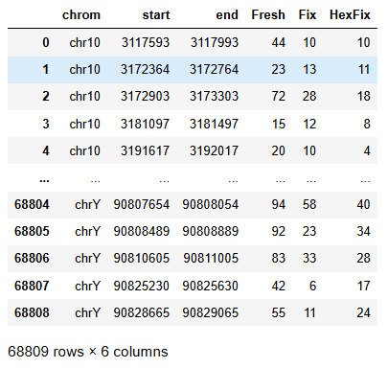
Data Normalization
As mentioned before, proper normalization is necessary before comparison between groups. But even before that, let us take a closer look at our data:

Slide 11
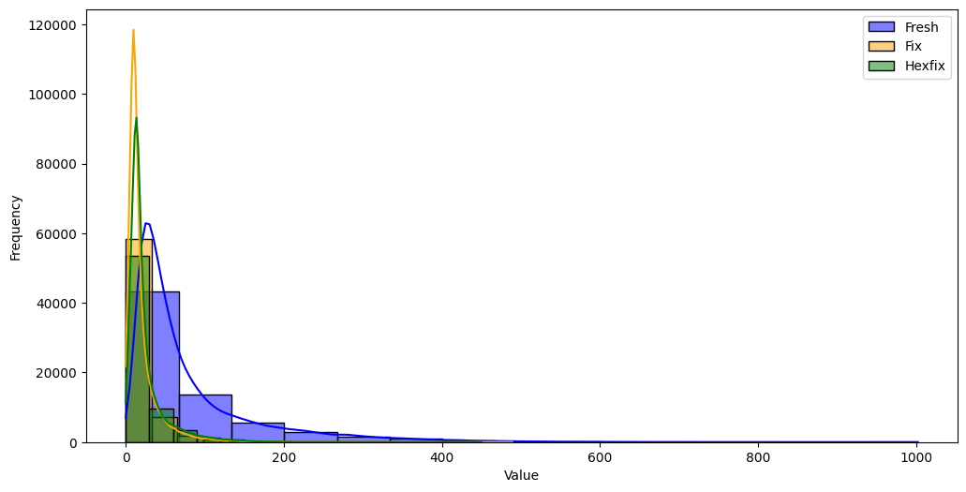
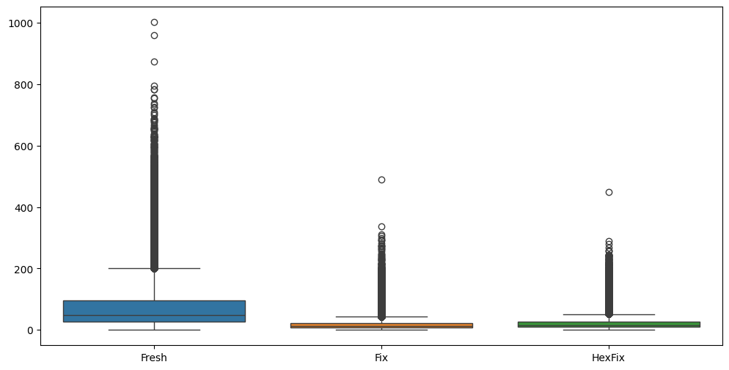
From both the histogram and the box plot we can see that the data is very skewed to the right, and also the three columns are of different “scale”.

Slide 12
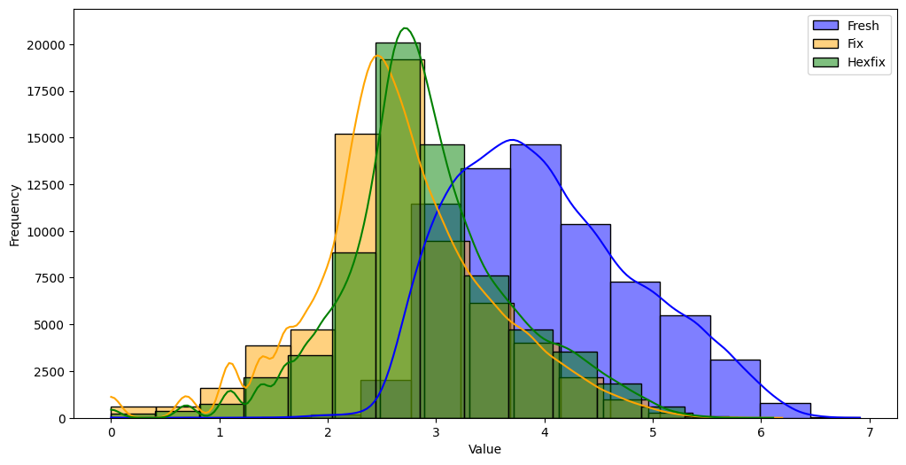
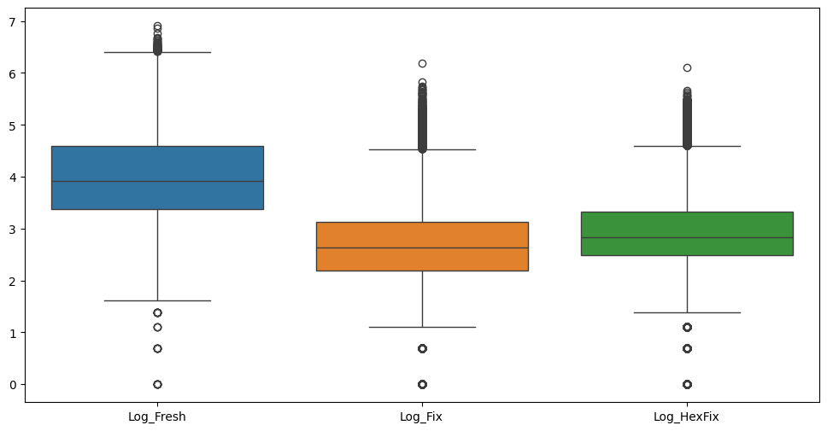
One common approach to deal with data with a long tail is to apply a log transformation. Here, a log2 transformation is used. Can see the data become more “normal” after applying the log transformation.

Slide 13
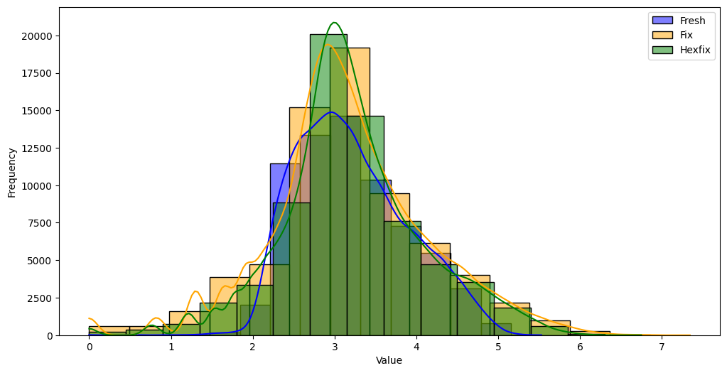
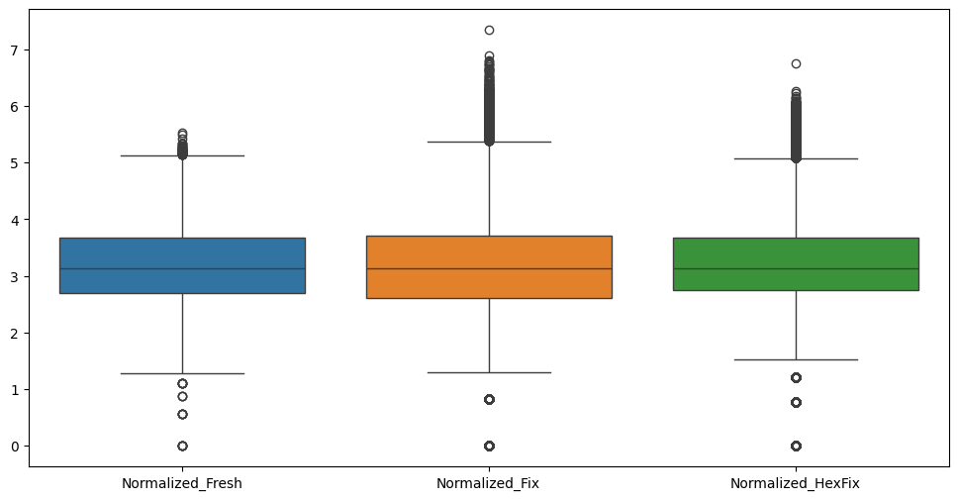
In the field of biological information, quantile normalization is commonly used⁽²⁾. In this project, Median normalization (MED), or the 50-quantile normalization is used. This method lines up the median of each column to make the data be on the same “scale”.

Slide 14
Data Transformation
Now we have 3 normalized columns. Before we feed the data to a clustering algorithm to generate the labels, it is better to apply certain transformations that better capture the feature we care about, and hopefully could improve the clustering result.
Some possible transformation methods are:
Z-score transformation (does not do a significantly better job to capture wanted features, and might have problems)
Difference transformation (simple and effective)
HSV transformation

Slide 15
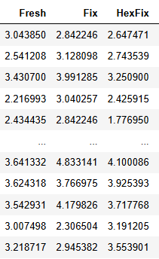
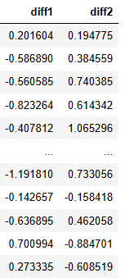
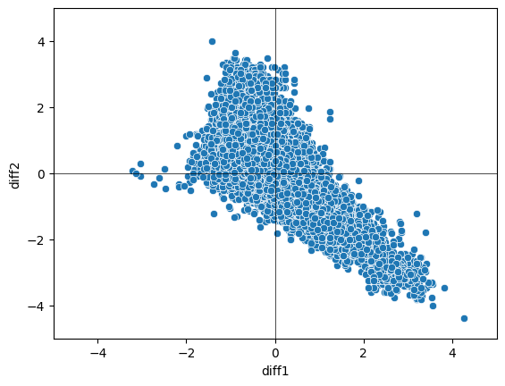
Difference transformation
Transform (Fresh, Fix, HexFix) to (Fresh - Fix, Fix - HexFix)
Advantage: focuses on the difference feature we care about, dimension reduction, visualization possible
Disadvantage: loss of information

Slide 16
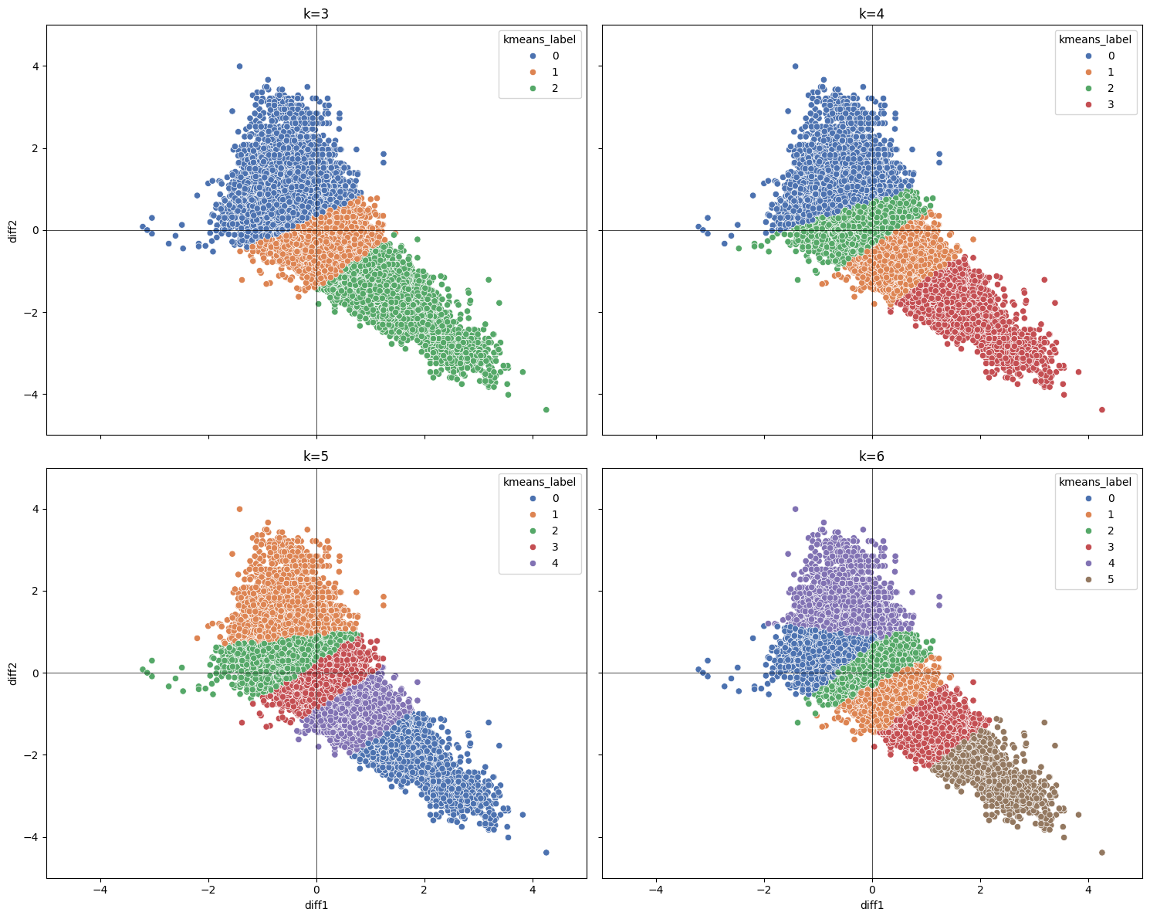
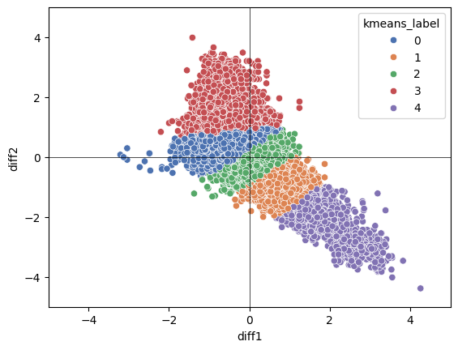
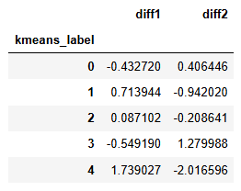

Kmeans
Kmeans result for k=5
Mean of each label

Slide 17
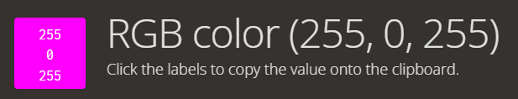
HSV transformation
Say we have a tuple (R, G, B) representing a color. Imagine you have a V-shape pattern for the RGB values (high R and B value, low G value), what color could it possibly look like?
Could it be that the V-shape pattern we are looking for is simply within a specific color range when converted into a RGB color?

Slide 18
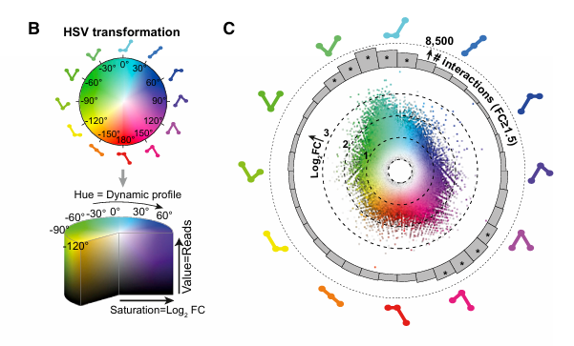
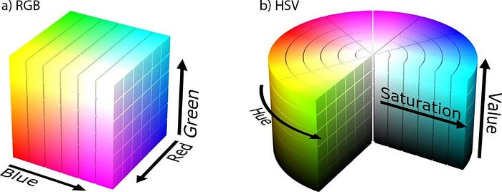
Indeed this is the case! If we treat the (Fresh, Fix, HexFix) tuple as RGB values of a color, all V-shape tuples should represent a color within a certain color range, in other words, a color which hue is in a certain range (when transform a RGB color into a HSV color).
Siersbæk et al., 2017. ⁽³⁾

Slide 19
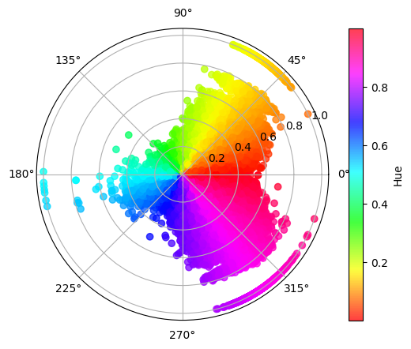
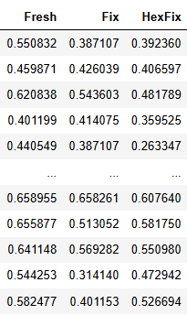
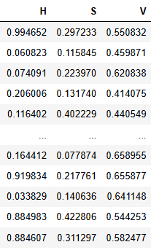
The columns are normalized to be between [0, 1] for convenience of HSV transformation
HSV values are also between [0, 1]

Slide 20
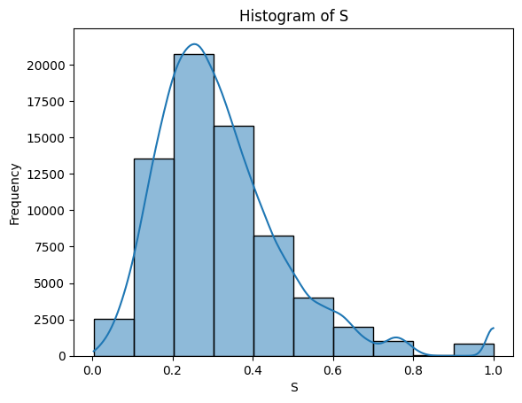
Interpretation of HSV transformation
For a (R, G, B) to (H, S, V) transformation:
H is the “shape” of the R-G-B angle
S is (max – min) / max, where max, min are the maximum, minimum value in (R, G, B)
V is the max value in (R, G, B)
Except for certain H range (the V-shape), we also look for certain S range (how deep the V is).

Slide 21
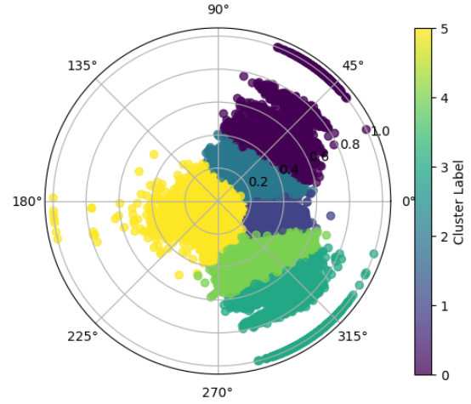
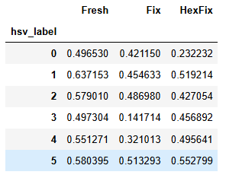

Kmeans
Mean of each label
Count of each label

Slide 22
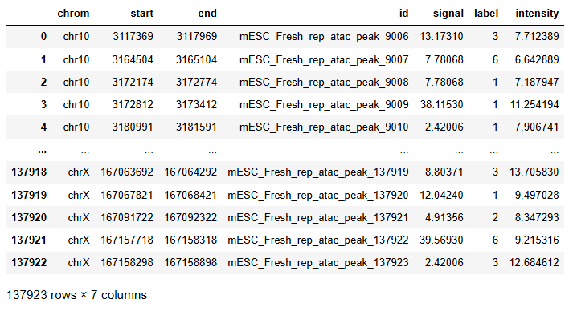
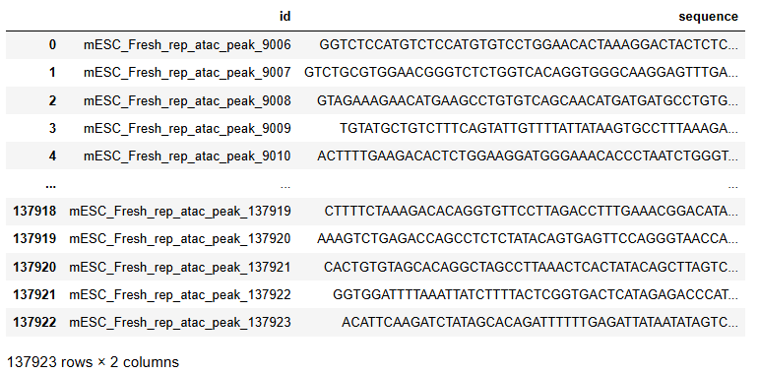
Data cleaning
The second subset comes in a very strange format (at least strange to me): .bed and .fa file.
.bed file can be read by pandas using the read_csv function and use ‘\t’ as delimiter.
.fa file is generated by a software called FASTA, which is wildly used in bioinformatics to store nucleotide or protein sequences. In python, it has to be read using special package functions (SeqIO function from Bio package).
This is what the dataset looks like, it is thus easy to see that the two tables can join on a common key, id:

Slide 23
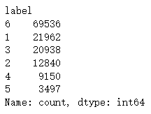
There are some problems to be solved before this data could be used to train a model. First, the labels of the peaks are from 1 to 6, while labels 1 to 5 represent class 0 to 4 in the Kmeans result in former step, while label 6 represents “unlabeled”. Thus, we have to delete all rows with label 6 (this is nearly half of the data), and reduce all label by 1 to get the original label we generated from the clustering algorithm.
I also swap label 0 with label 4, so that label 0 now represents the V-shape we are looking for. This saves time for me to remember which label is the label we target at.

Slide 24
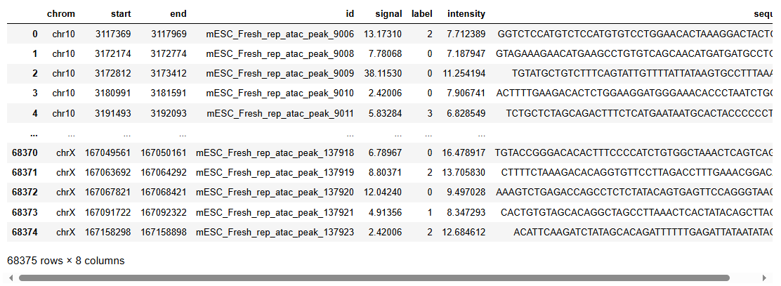
Another problem is that, besides A, T, C, and G, there is also a N nucleotide in the sequence column, which represents “unknown” or “any” nucleotide. We do not want this noise in our model, so I want to delete all rows whose sequence contains the N nucleotide.
This is what the data looks like after data cleaning:
While we got rid of nearly half the data, we still have about the same amount of rows in remain comparing to the first dataset, so it’s not too bad.

Slide 25
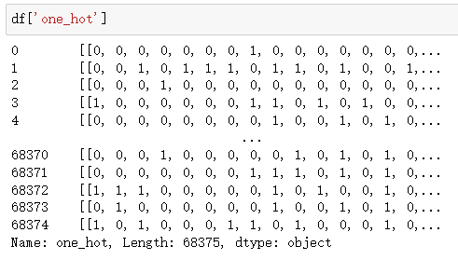
One-hot encoding
A common approach to extract patterns from a sequence in bioinformatics is to one-hot encode the sequence, so that a sequence of length n becomes a matrix of 4*n. This matrix is then fed into a CNN to extract the spatial information for further analysis. The methodology used in this project has referred to a paper by Han Yuan and David R. Kelley (2022)⁽⁴⁾.
This is how the one-hot encoding looks like:

Slide 26
CNN architecture
Because of the property of one-hot encoding, namely that each column can only have on “1” entry, the row-wise relationship (or between-row) is naturally of less significance than column-wise relationship (or within-row). This has led to a certain kind of CNN architecture we use in this project.
Instead of the Conv2d layer, which has a 2d kernel and is usually used on spatial data, here we use Conv1d layer, which has a 1d kernel and is usually used on sequential data. In this specific example, we treat each row as a individual sequence and apply Conv1d layer to it to get a new sequence for each channel. This approach has corresponding bioinformatics significance, for example, the first row could be imagined as the distribution for ‘A’ nucleotide.

Slide 27
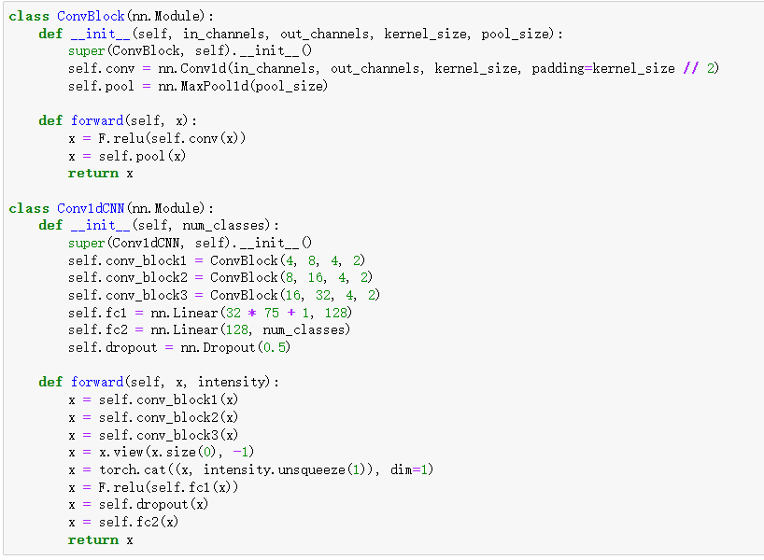
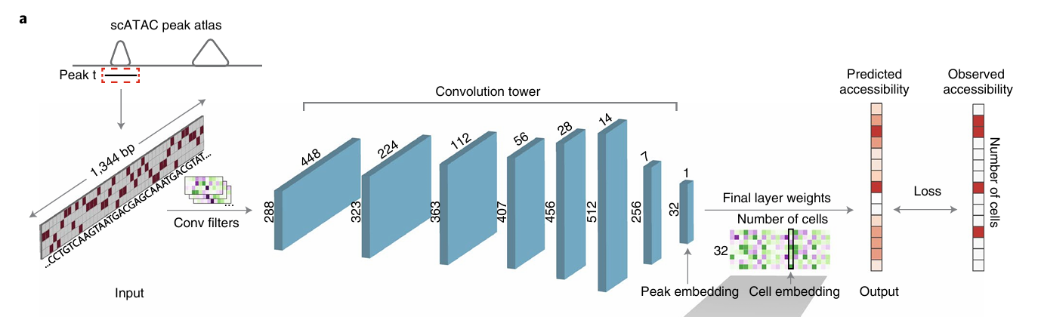
CNN architecture
The CNN architecture design also have referred to the paper by Han Yuan and David R. Kelley (2022)⁽⁴⁾.

Slide 28
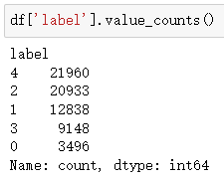
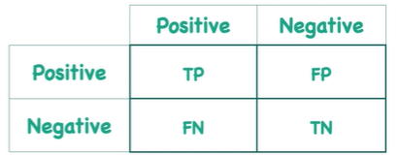
Training and evaluation
Data is randomly sampled from the original dataset with a 80%/20% train/test split ratio
Default sample size 20000 (16000 training data and 4000 validation data)
Use cross entropy loss
Learning rate set to be 0.001, with 1e-4 weight decay
Train 20 epochs, record the training and validation loss for each epoch, plot the loss when finished
Evaluate on both the overall accuracy and the accuracy on our target label (label 0 in this case) to prevent the model from biased of unbalanced label number

Slide 29
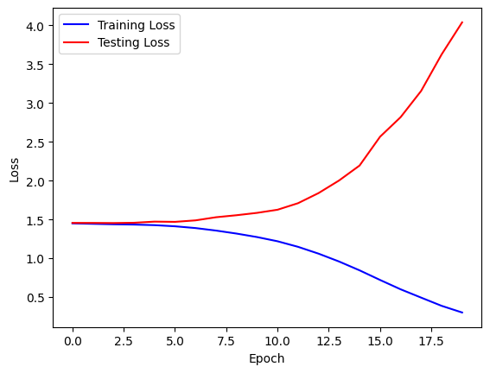
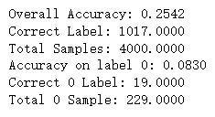
Result
Long story short, the CNN model does not work out well. The validation loss almost always goes up immediately after the training loss starts to go down (as shown below). This is a strong sign of overfitting in ML, where the model simply “remember” the data instead of “learn” the underlying pattern, which makes the model impossible to generalize to unseen data.

Slide 30
Discussion
Several possible reasons might lead to this result:
There’s a problem with the data
The data has too little pattern/too much noise
The labels have poor quality
There’s a problem with the model
The model is too complicated for the data
The model architecture does not fit the data

Slide 31
Future plan
Currently, I am working on testing different hyperparameters as well as different architecture design. By doing so, I hope to rule out the possibility that there is a problem with model selection or the training process.
Meanwhile, my colleagues are working on feature engineering of the original input data, namely on doing experiments to record the complete distribution of the sequences’ intensity (we only have the average by now). They believe this should provide some extra information for the model to learn an underlying pattern.
If we somehow manage all these above and it still does not work, we might go back to the part of how we generate the labels. Some new ideas already come up, for example, use a regression model to regress the possibility of a peak being V-shape instead of using clustering algorithms.

Slide 32
Links
Project repository: https://github.com/N1colTeng/DATA-294P
Link to presentation video: https://youtu.be/KirmEBSLh5Q

Slide 33
Reference
(1) He et al., 2024, Cell. Dual-role transcription factors stabilize intermediate expression levels.
(2) Beibei Wang, Fengzhu Sun & Yihui Luan, 2024. Comparison of the effectiveness of different normalization methods for metagenomic cross‑study phenotype prediction under heterogeneity.
(3) Siersbæk et al., 2017, Molecular Cell 66. DynamicRewiring of Promoter-Anchored Chromatin Loops during Adipocyte Differentiation.
(4) Han Yuan and David R. Kelley, 2022. scBasset: sequence-based modeling of single-cell ATAC-seq using convolutional neural networks.

